Slide 1


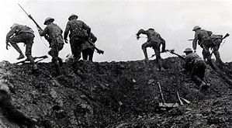
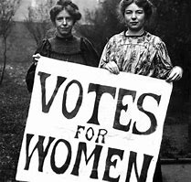

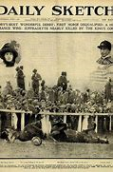
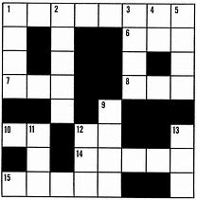


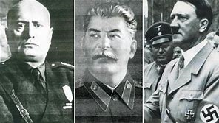
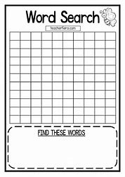
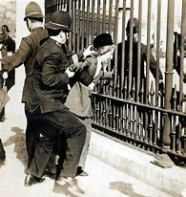

Year 9 History Homework Spring Term Challenge
 | Create a game to teach about the Suffragettes e.g. board game, card game. | Design an attention grabbing webpage about a major battle of World War One. | ‘The actions of the Suffragettes led to the vote for women.’ Impress me with your response to this.
 | Write a ‘Beginner’s guide to being a Suffragette – what to wear, say and do’. | Create a newspaper front page about Emily Davison. | Produce a crossword (cryptic?) on the dictators.
 | Design a quiz (10 questions) on the dictators. | Produce a wordsearch containing at least 15 keywords about World War One. | Create a starter activity for a lesson about the Suffragettes.
Each gold activity will take at least 1 hour to complete
Each silver activity will take at least 30 minutes to complete
Each bronze activity will take at least 20 minutes to complete
Will you take on the Gold, Silver or Bronze challenge? Don’t forget to hand work in to your teacher for OBHS Habits cards and positive points. The very best will get points towards the OBHS Award on Go 4 Schools.

